Slide 1

Shuffled Frog Leaping Algorithm
By Kevin Chan

Slide 2
Agenda
Understanding Shuffled Frog Leaping Algorithm
Basic Example
Notes:
Put image here

Slide 3
What is SFLA?
Biological animal behavior algorithm
Meta-heuristic algorithm for combinatorial-type optimization problems
Frogs in a swamp helping one another find the place with the most food
Candidate solutions in a feasible set helping each other find optimum

Slide 4
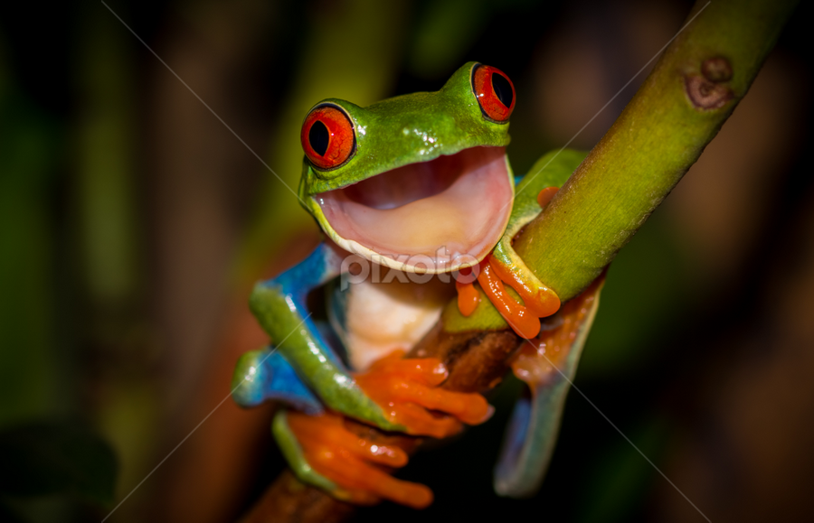
Why is SFLA useful?
Can be used in complex hydrology and neural network applications
  Water distribution networks*, groundwater model calibration
  LeNet training on classification
Global optimality as time t goes to ∞
Growing in popularity
Wow, so cool!!!
Notes:
Water may evaporate, run off on the surface, or infiltrate and move through the soil or ground water, making the

Slide 5
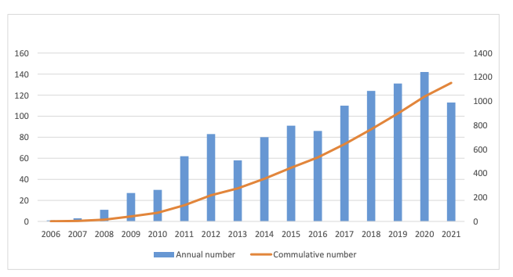
Maaroof et al. 2022

Slide 6

So how do we apply SFLA?

Slide 7
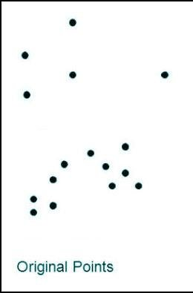
State Initialization
Create a population of frogs denoted with U₁, U₂, …, U_{F}
Frog i is a decision vector variable such that:
U_{i} = U_{i}¹, U_{i}², …, U_{i}^{d} where d defines the number of decision variables for each frog
Alhenaki, L. 2019.

Slide 8
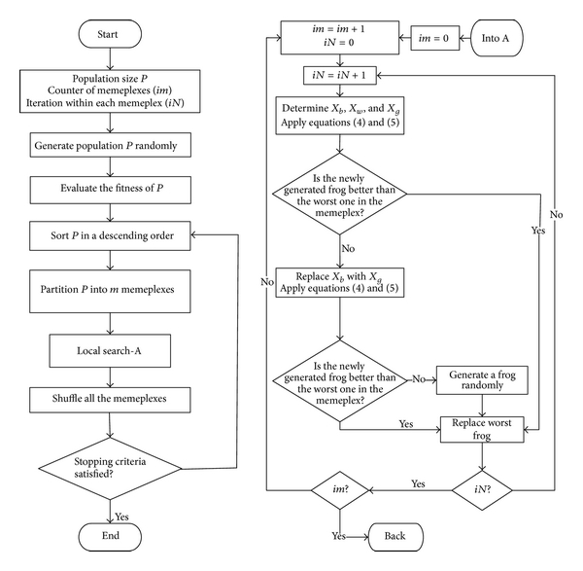
Global Algorithm
Han et al. 2013.
1) Define:
m - the number of memplexes
n - the number of frogs within each memeplex
im - the counter for the memeplexes
in - the counter for the sub-memeplexes
N - the number of local evolutionary steps
2) Generate the population with F = m * n such that each frog is in the feasible space Ω
Ω ∈ S^{d}
3) Evaluate the fitness of each frog with function f

Slide 9
Global Algorithm Part 2
Han et al. 2013.
4) Rank the F many frogs in descending order based on the fitness function
Can use U_{i} as notation for i = 1, ..., F where i = 1 is the first best frog
5) Divide the frogs into memeplexes in order of the descending order
6) Evolve the memetic by entering local exploration!

Slide 10
Where are we now?
Han et al. 2013.
Here!

Slide 11

Local Search Strategy
Han et al. 2013.
1) Add one to the counter for im to signify the beginning of a local search
2) Create a sub-memeplex by choosing q-many frogs within each memeplex according to a triangular probability distribution where greater weights are given to frogs with greater performance:
Let the best frog in the sub-memeplex have position P_{B} and the worst fitness frog in the sub-memeplex have position P_{W}.

Slide 12

Local Search Strategy Part 2
Han et al. 2013.
3) Arrange the q frogs in the sub-memeplex in descending order and set iq = 1 as the index of the best frog
4) Calculate the step size S with the following equations:
where rand represents a random number in the range [0,1] and S_{max} represent the maximum step size for the frog to “jump”.
5) Then perform the update:
U_{(q)} = P_{W} + S
to the position of the worst frog.

Slide 13
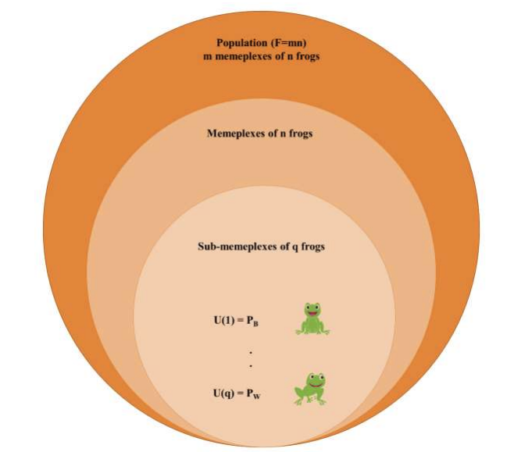
Maaroof et al. 2022.

Slide 14
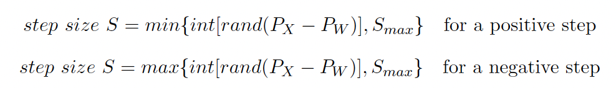
Local Search Strategy Part 3
Han et al. 2013.
6) Now we must assess the fitness of the new “worst” frog. If the new U_{(q)} exceeds the previous U_{(q)} then we perform the local exploration again. If it is not, then we progress to the next step of the diagram.
7) We now must perform the following update:
and do:
U_{(q)} = P_{W} + S

Slide 15
Local Search Strategy Part 4
Han et al. 2013.
8) See if the newly generated frog U_{(q)} is indeed better than the worst one within the sub-memeplex. If no, then we generate a new frog within the sub-memeplex to replace the worst frog. If yes, then we replace the worst frog. We then update the memeplex.
9) We check if iN < N to see if we have finished our local searches for the sub-memeplex. If yes, we perform the local search again. If not, then we increment im.
10) If im < m, we perform another round of local updates by redefining sub-memeplexes. If im = m, then we move back to global search to shuffle the memeplexes.

Slide 16
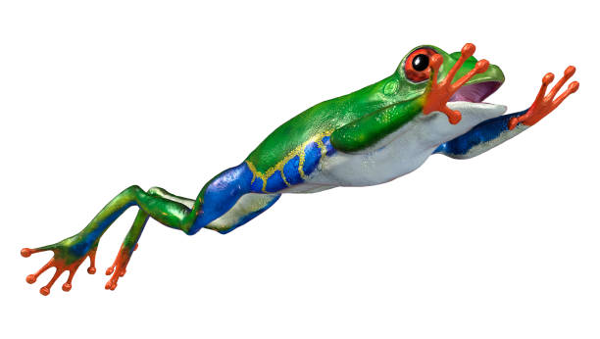
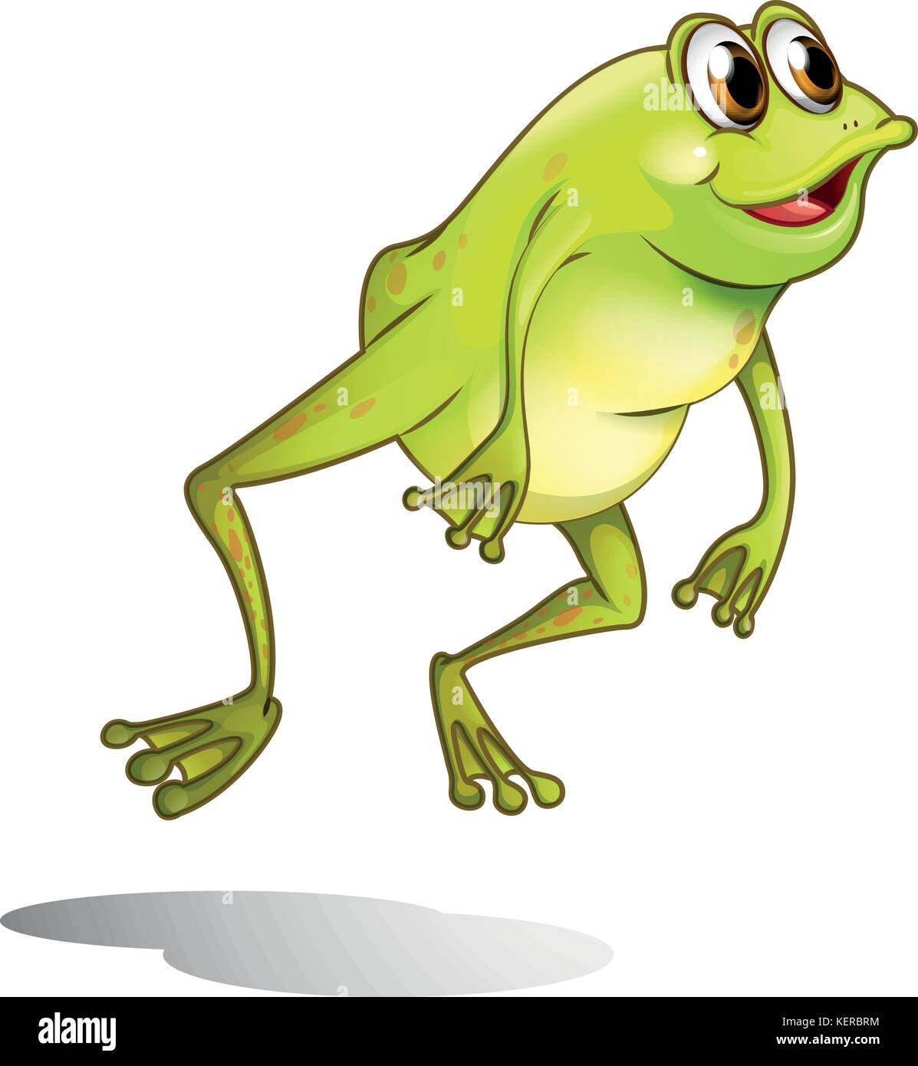
We have now fully performed one batch of local searches for our memeplexes!

Slide 17
Global Algorithm Part 3
Han et al. 2013.
7) We now shuffle the memeplexes and reorganize them based on all of the frogs current fitness values using the same ordering scheme.
8) We verify convergence criterion. If criterion is met, then we stop the SFLA process. If it is not, then we continue and rank the frogs again.

Slide 18




Basic Example Time!
Github: SaadHasib

Slide 19
Thank you!

Slide 20
References
Alhenaki, Lubna. 2019. A Genetic-Frog Leaping Algorithm for Text Document Clustering. ResearchGate. LINK
Han et al. 2013. Shuffled Frog Leaping Algorithm for Preemptive Project Scheduling Problems with Resource Vacations Based on Patterson Set. Journal of Applied Mathematics. doi: 10.1155/2013/451090
Maaroof et al. 2022. Current Studies and Applications of Shuffled Frog Leaping Algorithm: A Review. Archives of Computational Methods in Engineering 29. 3459-3474. doi: 10.1007/s11831-021-09707-2Abs1
Saadi, S. et al. 2022. Investigation of Effectiveness of Shuffled Frog-Leaping Optimizer in Training a Convolutional Neural Network. Journal of Healthcare Engineering. doi: 10.1155/2022/4703682

